Slide 1

Welcome to Bootcamp!

Slide 2


What is a data scientist? And how will you become one?

Slide 3

The Data Science Venn Diagram
Notes:
http://drewconway.com/zia/2013/3/26/the-data-science-venn-diagram

Slide 4
Skill Domains of a Data Scientist
Math & Machine Learning Probability, Statistics, Linear Algebra, Calculus, Machine Learning Algorithms
Programming Programming Skills
Communication Communication Skills, Design Skills, Domain Expertise

Slide 5
Personality Traits of a Data Scientist
Curiosity Continuous drive to learn
Creativity Looking at problems from different angles and ideas
Grit Ability to push through walls

Slide 6
Personality Traits of a Data Scientist
Integrity Be honest
Humility Be humble
“If you don’t understand something, be honest and let us know. If you do know something really well, be humble and teach others.”

Slide 7
For the next three months, you will have…
Focused Time
Peer & Community Support
Experienced Instructors
Career Support

Slide 8
The Bootcamp Model

Slide 9
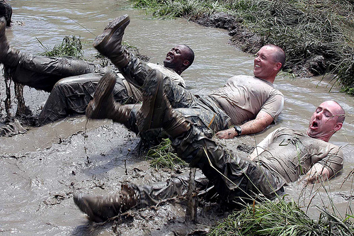
Training
Repetition
Culture & Community

Slide 10
1. Training

Slide 11
1. Training: Skills
O
S
E
M
N
Notes:
The awesome approach to data science, by Hilary Mason (http://www.dataists.com/2010/09/a-taxonomy-of-data-science/)

Slide 12
1. Training: Skills
Obtain
Scrub
Explore
Model
iNterpret
Communicate

Slide 13
1. Training: Skills
Obtain – Data Acquisition
Scrub – Data Cleaning
Explore – Data Exploration, Statistics
Model – Machine Learning
iNterpret – Domain Expertise
Communicate – Data Visualization, Storytelling

Slide 14
1. Training: Tools
Python when possible
Comfort with core toolbox
Awareness of other options

Slide 15
1. Training: Tools
Python, Jupyter Notebook, Git / Github
pandas, numpy, matplotlib, seaborn
statsmodels, scikit-learn
Beautiful Soup, Selenium
(Flat Files), PostgreSQL, MongoDB
Amazon Web Services
HTML, CSS, Flask
Google

Slide 16
2. Repetition

Slide 17
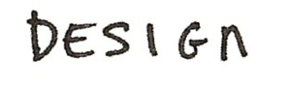
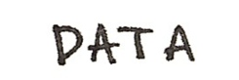
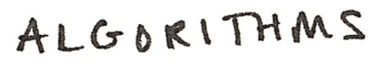
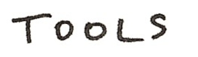
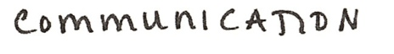

2. Repetition: Project-Based Model

Slide 18
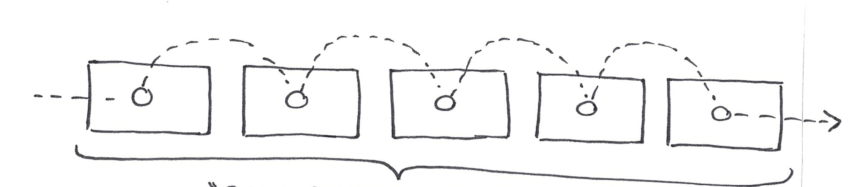
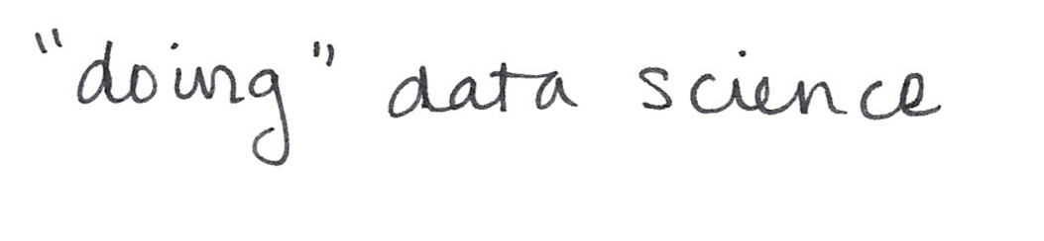
2. Repetition: Project-Based Model
Unit of repetition = the practice of doing data science

Slide 19

2. Repetition: Partitioning 12 Weeks

Slide 20
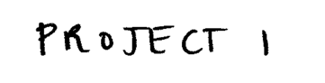
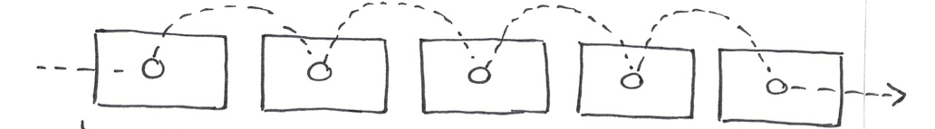
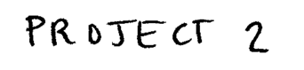
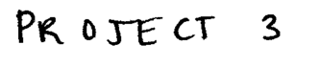
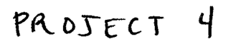
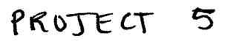
2. Repetition: Partitioning 12 Weeks

Slide 21
3. Culture & Community

Slide 22
3. Culture & Community
You must overcome two things:
1. Imposter Syndrome
2. Perfectionism

Slide 23
3. Culture: Imposter Syndrome

Slide 24
3. Culture: Imposter Syndrome
You must overcome two things:
1. Imposter Syndrome
Group work
Communication
2. Perfectionism
Notes:
Can overcome by working in groups – realize everyone else is on the same page and you may be able to bring your own expertise in to teach the group something.
Constantly communicate with the instructors. It’s okay if you don’t know something. We’re here to make sure you understand the material and get a job at the end.

Slide 25
3. Culture: Perfectionism
You must overcome two things:
1. Imposter Syndrome
Group work
Communication
2. Perfectionism
Unfairly short deadlines
Jumping into the unfamiliar

Slide 26
3. Community: Becoming Data Scientists
Mixture of individual and group work
Instructors, Program Manager and Career Advisor support
Guest speakers and Meetups
Hiring partners
Metis alumni network

Slide 27
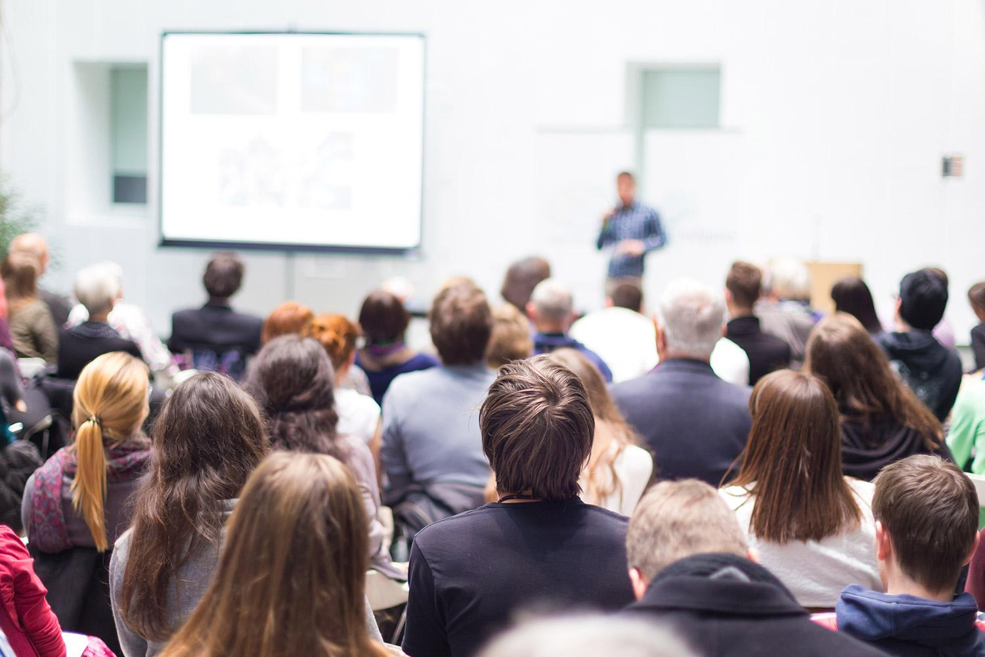
“The classroom instruction, project work, and resources offered through the career counseling and continued alumni support is invaluable. I was exhausted every day, but I woke up looking forward to every day.”
– Metis Alumni
“”

Slide 28
QUESTIONS?

